Slide 1
Web Programming Language
Week 10
Getting Started with REACT

Slide 2
Getting Started with React
A New Project
JSX
Components
props
Event handlers

Slide 3
Modern Web Development
The Choices
Angular
React
Vue
Svelte

Slide 4
React
A JavaScript library for building user interfaces

Slide 5
Environment Set Up
Recent version of Node
Editor - VSCode

Slide 6
create-react-app
Use Node to set up your first react project
In terminal type:-
npx create-react-app firstapp
“Installing packages. This might take a couple of minutes.”

Slide 7
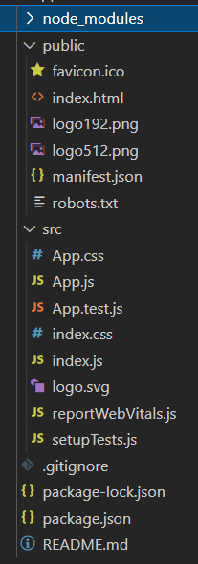
Initial Set Up
node_modules
All the dependencies that have just been installed
public folder
Contains the single index.html file
src folder
The source, where we will do most of our work

Slide 8
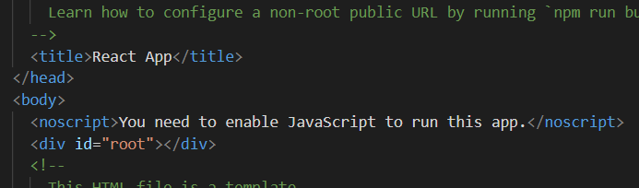
index.html
Not much to see here, but notice the single div;
<div id=“root”></div>
This is where the react app will be injected.

Slide 9
src folder
Some files we won’t use, so we can delete;
App.test.js
reportWebVitals.js
setupTests.js
That leaves;
App.css
App.js
index.css
index.js
& a logo

Slide 10
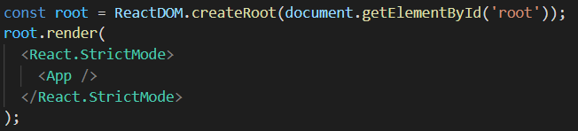
index.js
Since we aren’t using reportWebVitals, you can delete the references to that
Import & function call.
Now the file has some imports, but notice;
This is where the App gets rendered to that root div.

Slide 11
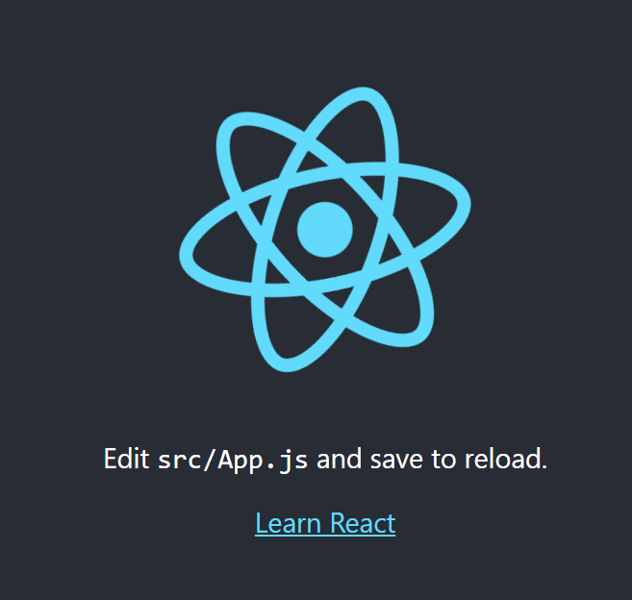
Start it up
Back in the console you can launch your server
cd firstapp
npm start
This should launch your browser to localhost:3000

Slide 12
App.js
A function called App(), which appears to contain html
Actually it is JSX code
Try editing it, and see what happens in your browser!

Slide 13
JSX
JSX is JavaScript XML
Lets us write HTML in React (in js files)
JSX converts HTML tags into react elements
Traditional JS would mean using createElement() and or appendChild()

Slide 14
Expressions in JSX
We can write expressions inside braces {}
const myElement = <p>5 * 5 = {5*5}</p>;
Notice in App.js
<img src={logo} className="App-logo" alt="logo" />

Slide 15
Multiple Lines of HTML
Should be in brackets;
const myElement = ( <ul> <li>Dogs</li> <li>Cats</li> <li>Fish</li> </ul> );

Slide 16
One Top Level Element
HTML must be wrapped into a single parent, such as a <div>
const myElement = ( <div> <p>Paragraph 1</p> <p>Paragraph 2</p> </div> );
Or a Fragment
const myElement = ( <> <p>Paragraph 1</p> <p>Paragraph 2</p> </> );

Slide 17
Close Elements
All elements in JSX must be properly closed!
const myElement = <input type=“text” />;
Notice in App.js
<img src={logo} className="App-logo" alt="logo" />

Slide 18
class = className
The word ‘class’ is a reserved word in JavaScript, so we can’t use it in JSX
Use className instead
const myElement = <p className=“myClass”>Hello</p>
Notice in App.js
<img src={logo} className="App-logo" alt="logo" />

Slide 19
if
if statements are supported in react, but not in JSX…
const x=5; if(x>10) {let size = “Big”;} else {let size = “Small”;} const myElement = <p>{size}</p>
Or, use the ternary operator
const x=5; const myElement = <p>{(x)>10 ? “Big” : “Small” }</p>;

Slide 20
Example
const App = () => { const handleNameChange = () => { const names =['Ken', 'Matty', 'Danny’]; const int = Math.floor(Math.random() * 3); return names[int]; }
return ( <div className="App"> <p>Hello {handleNameChange()}</p> </div> );
}

Slide 21
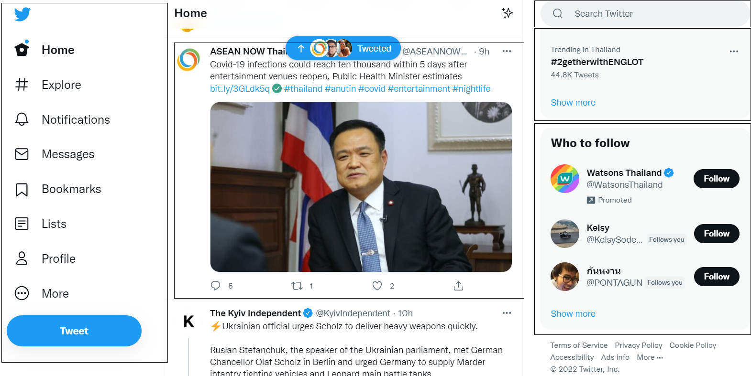
React Components
Your page is composed of a variety of components

Slide 22
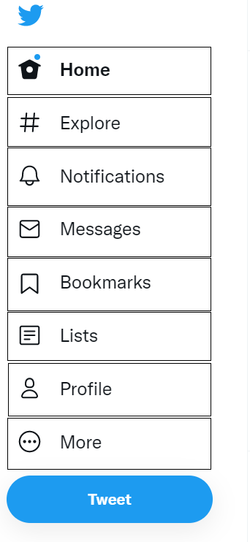
React Components
Each Component is comp0sed of components
Which can then be reused

Slide 23
components/Tweet.js
import './Tweet.css’;
const Tweet = () => { return ( <div className="Tweet"> <h1>Title</h1> <p>Content</p> <p>Likes</p> </div> ); }
export default Tweet;

Slide 24
components/Tweet.css
.Tweet { text-align: center; border: 1px solid black; width: 400px; }

Slide 25
App.js
import './App.css’; import Tweet from './components/Tweet’ const App = () => { return ( <div> <Tweet /> <Tweet /> <Tweet /> </div> ); } export default App;

Slide 26
props
props are properties that can be sent to a function component.
const Tweet = (props) => { return ( <div className="Tweet"> <h1>{props.title}</h1> <p>{props.content}</p> <p>Likes: {props.likes}</p> </div> );
}

Slide 27
Sending props
const App = () => { return ( <div> <Tweet title="My First Tweet" content="Awesome!" likes="3" /> <Tweet title="Hello World" content="Welcome to my world" likes="2" /> <Tweet title="Nice Day" content="For learning React" likes="10" /> </div> ); }

Slide 28
Snippets!
In VSCode you can add the following extension
ES7 React/Redux… Snippets
Then when you create a new component (in windows)
Type Ctrl+Alt+R
Then type ‘rafce’

Slide 29
A Footer?
import React from 'react’ const Footer = () => { const today=new Date(); return ( <footer> <p>Copyright &copy; {today.getFullYear()}</p> </footer> ) } export default Footer

Slide 30
Events
We can build event handlers in React to handle things like ‘click’
The same events as in HTML
Events are written in camelCase
onClick rather than onclick
Event handlers are in braces
onClick={action} rather than onClick=“action()”

Slide 31
Event Example
Add the handler
const action = () => { console.log("Tweet!"); }
Add the call
<h1 onClick={action}>{props.title}</h1>

Slide 32
Passing Arguments
Using an anonymous function
const action = (a) => { console.log(a); }
And
<h1 onClick={() => action("Tweet Again!")}>{props.title}</h1>

Slide 33
The Event Object
We can pass the Event Object
<h1 onClick={(e) => action(e)}>{props.title}</h1>
(Console log to see what information in contains!)
For example;
const action = (e) => { console.log(e.target.innerHTML); }

Slide 34
Key Points
React is a JavaScript Library for building user interfaces
JSX is used to write HTML in React
With a few minor differences
React can be used to create function components for different parts of the interface
We can send props (properties) to different components
We can create Event handlers to handle events such as clicks

